Slide 1
Fitness Classification for Workplace and Healthcare Safety
By Asish Jose

Slide 2
Problem Statement
- Goal: Predict whether a person is fit (1) or not fit (0).
- Critical objective: Minimize False Positives (FP) → Avoid labelling an unfit person as fit
- Applications: Ensuring safety in workplace health checks, sports selections, and preventive healthcare.

Slide 3
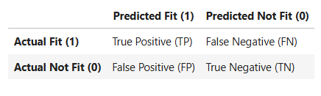
False Negative (FN): Actual Fit = 1, Predicted Not Fit = 0 → A person who is actually fit gets classified as not fit.
Impact: Might wrongly exclude them from opportunities (e.g., jobs, sports selection, medical clearance).
Expensive error if your application is about screening fit candidates.
False Positive (FP): Actual Not Fit = 0, Predicted Fit = 1 → A person who is not fit gets classified as fit.
Impact: Could allow an unhealthy person to pass as fit, leading to serious risks (e.g., workplace accidents, health failures).
More critical error in health or safety-sensitive applications.

Slide 4
Dataset Overview
- Total samples: 2000
- Features: 10 (9 predictors + 1 target)
- Target distribution: 60% not fit, 40% fit
- Missing values: ~8% in sleep_hours
- Outliers: Present in weight_kg (~2%)
- Data types: Mixed (int, float, categorical)

Slide 5
Column Descriptions
age – Age in years
height_cm – Height (cm)
weight_kg – Weight (kg) – outliers present
heart_rate – Resting heart rate (bpm)
blood_pressure – Systolic blood pressure (mmHg)
sleep_hours – Avg. daily sleep (hrs, may contain NaNs)
nutrition_quality – Nutrition quality score (0–10)
activity_index – Physical activity score (1–5)
smokes – Smoking status (0/1/yes/no)
gender – Gender (M/F)
is_fit – Target variable (1 = fit, 0 = not fit)

Slide 6
Data Preprocessing
- Missing values in sleep_hours handled using SimpleImputer
- StandardScaler applied to numerical features
- One-Hot Encoding used for categorical features (smokes, gender)
- Outliers in weight_kg identified and analyzed
- Dataset split into Train & Test sets

Slide 7
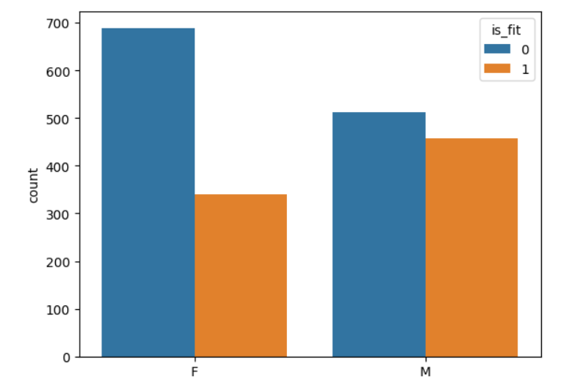
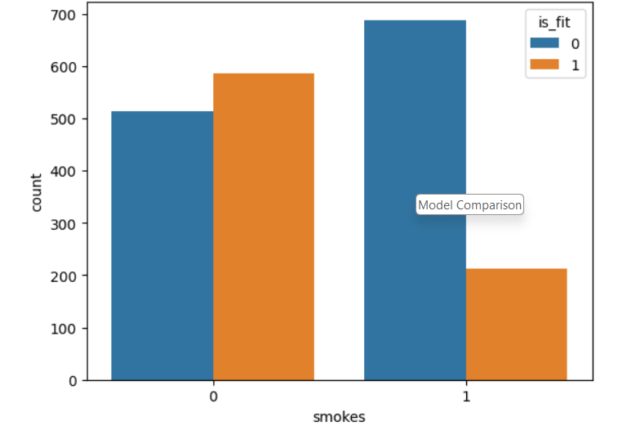
Exploratory Data Analysis (EDA)
- count plots of age, smokes, etc
- - Boxplots for outlier detection [Insert boxplots]
- Class balance check (60/40 split)
Distribution plots

Slide 8
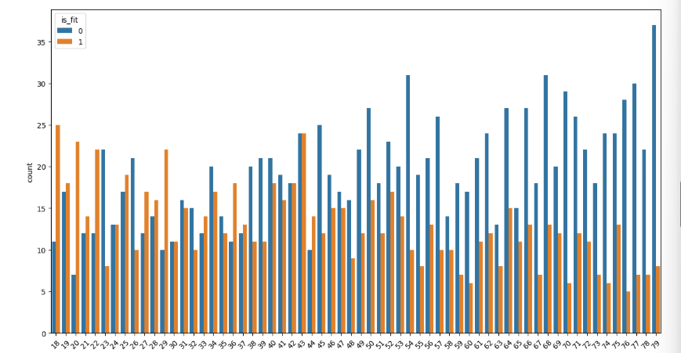
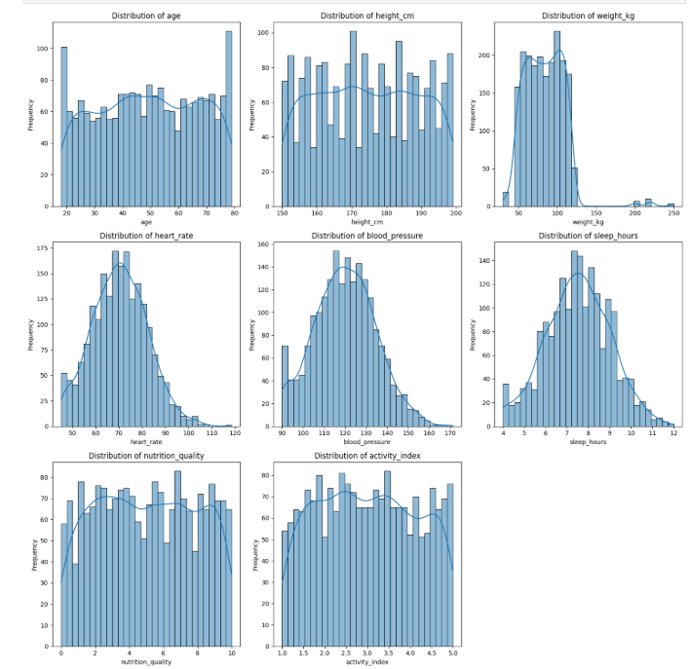
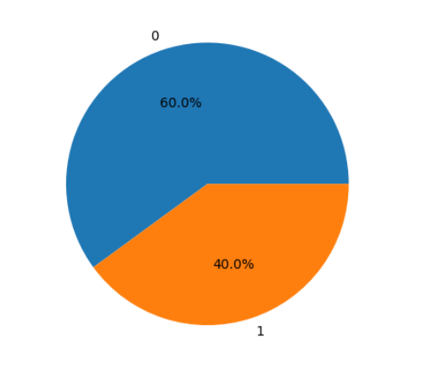

Slide 9
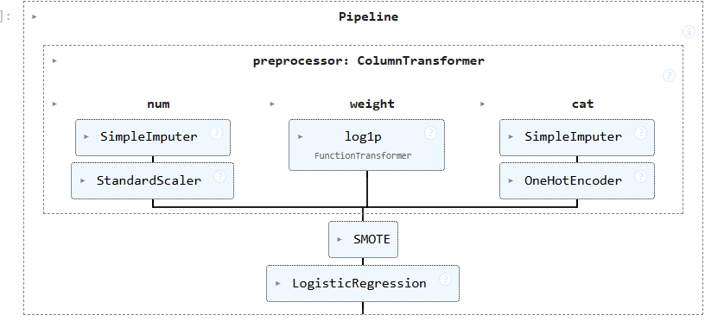
Model Building
- Started with Logistic Regression (baseline model)
- Applied advanced models:
• Random Forest Classifier
• Gradient Boosting Classifier
• XGBoost Classifier
- Goal: Compare performance across models

Slide 10
Evaluation Metrics
- Classification metrics:
• Accuracy
• Precision
• Recall
• F1-score
• ROC-AUC
Focus on Precision (Fit = 1 class): Ensures only genuinely fit individuals are classified as fit.
- Confusion Matrix used to analyze error types (FP, FN)
- Plotted ROC curves for all models [Insert ROC curves]

Slide 11
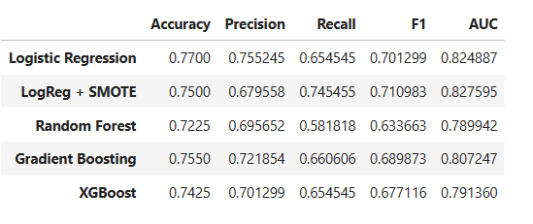
Model Comparison

Slide 12
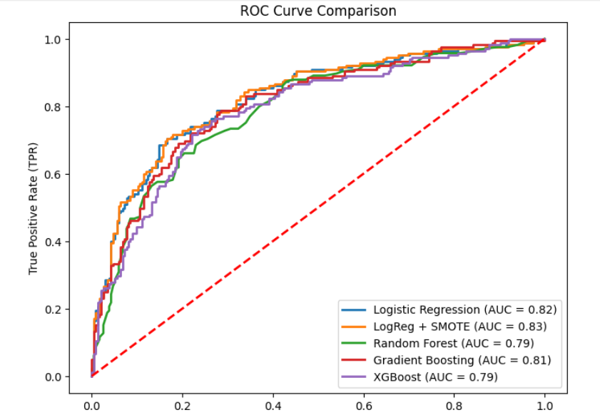

Slide 13
Key Insights
- - Precision was prioritized to minimize the risk of misclassifying unfit individuals as fit.
Features like activity_index, nutrition_quality, and sleep_hours were strong predictors of fitness
weight_kg outliers influenced classification performance, but scaling and preprocessing reduced impact
- Logistic Regression provided consistent performance despite being a simple linear model
- Complex models (RF, GBM, XGB) offered slightly higher accuracy but with added complexity

Slide 14
Conclusion
- Built and evaluated multiple classification models for predicting fitness
- Logistic Regression outperformed other models in terms of interpretability and balanced performance
- Evaluation using ROC-AUC, precision, recall, and F1-score ensured reliable model selection
- Correctly identifying unfit individuals prevents risks in health and safety-sensitive environments.

Slide 15
Future Scope
- Explore deep learning models for larger datasets
- Include additional features (diet details, stress levels, medical history)
- Handle outliers with robust scaling
- Improve generalization with cross-validation techniques

Slide 16
Thank You

